Slide 1
Chapter 1: Introduction

Slide 2
Outline
The Need for Databases
Data Models
Relational Databases
Database Design
Storage Manager
Query Processing
Transaction Manager

Slide 3
Data:
Data is raw, unorganized facts that need to be processed. Data can be something simple and seemingly random and useless until it is organized.
Information:
When data is processed, organized, structured or presented in a given context so as to make it useful, it is called information
Database :
The collection of data that contains information relevant to an enterprise is known as database.
Database Management System:
It is a collection of interrelated data and set of programs to access those data.

Slide 4
Database Management System (DBMS)
DBMS contains information about a particular enterprise
  Collection of interrelated data
  Set of programs to access the data
  An environment that is both convenient and efficient to use
Database Applications:
  Banking: transactions
  Airlines: reservations, schedules
  Universities: registration, grades
  Sales: customers, products, purchases
  Online retailers: order tracking, customized recommendations
  Manufacturing: production, inventory, orders, supply chain
  Human resources: employee records, salaries, tax deductions
Databases can be very large.
Databases touch all aspects of our lives

Slide 5
University Database Example
Application program examples
  Add new students, instructors, and courses
  Register students for courses, and generate class rosters
  Assign grades to students, compute grade point averages (GPA) and generate transcripts
In the early days, database applications were built directly on top of file systems

Slide 6
Drawbacks of using file systems to store data or
Purpose of database Systems
Data redundancy and inconsistency
  Multiple file formats, duplication of information in different files
Difficulty in accessing data
  Need to write a new program to carry out each new task
Data isolation
  Multiple files and formats
Integrity problems
  Integrity constraints (e.g., account balance > 0) become “buried” in program code rather than being stated explicitly
  Hard to add new constraints or change existing ones

Slide 7
Drawbacks of using file systems to store data (Cont.)
Atomicity of updates
  Failures may leave database in an inconsistent state with partial updates carried out
  Example: Transfer of funds from one account to another should either complete or not happen at all
Concurrent access by multiple users
  Concurrent access needed for performance
  Uncontrolled concurrent accesses can lead to inconsistencies
    Example: Two people reading a balance (say 100) and updating it by withdrawing money (say 50 each) at the same time
Security problems
  Hard to provide user access to some, but not all, data
Database systems offer solutions to all the above problems

Slide 8
Levels of Abstraction
Physical level: describes how a record (e.g., instructor) is stored.
Logical level: describes data stored in database, and the relationships among the data.
  type instructor = record
  ID : string;
  name : string;
  dept_name : string;
  salary : integer;
        end;
View level: application programs hide details of data types. Views can also hide information (such as an employee’s salary) for security purposes.

Slide 9

View of Data
An architecture for a database system

Slide 10
Instances and Schemas
Similar to types and variables in programming languages
Logical Schema – the overall logical structure of the database
  Example: The database consists of information about a set of customers and accounts in a bank and the relationship between them
    Analogous to type information of a variable in a program
Physical schema– the overall physical structure of the database
Instance – the actual content of the database at a particular point in time
  Analogous to the value of a variable
Physical Data Independence – the ability to modify the physical schema without changing the logical schema
  Applications depend on the logical schema
  In general, the interfaces between the various levels and components should be well defined so that changes in some parts do not seriously influence others.

Slide 11
Data Models
A collection of tools for describing
  Data
  Data relationships
  Data semantics
  Data constraints
Relational model
Entity-Relationship data model (mainly for database design)
Object-based data models (Object-oriented and Object-relational)
Semistructured data model (XML)
Other older models:
  Network model
  Hierarchical model

Slide 12

Relational Model
All the data is stored in various tables.
Example of tabular data in the relational model
Columns
Rows

Slide 13
A Sample Relational Database

Slide 14
Data Definition Language (DDL)
Specification notation for defining the database schema
  Example: create table instructor (
  ID char(5),
  name varchar(20),
  dept_name varchar(20),
  salary numeric(8,2))
DDL compiler generates a set of table templates stored in a data dictionary
Data dictionary contains metadata (i.e., data about data)
  Database schema
  Domain constraint
    Data type
  Integrity constraints
    Primary key (ID uniquely identifies instructors)
  Assertions
  Authorization
    Who can access what

Slide 15
Data Manipulation Language (DML)
Language for accessing and manipulating the data organized by the appropriate data model
  DML also known as query language
Types of access:
  Retrieval of Information
  Inserting new Information
  Deletion of information
  Modification of information
Two classes of languages :
  Procedural DMLs:
  What data are needed and how to get those data
  Declarative (nonprocedural) DMLs:
  What data are needed without specifying how to get those data.

Slide 16
SQL
The most widely used commercial language
SQL is non procedural language
To be able to compute complex functions SQL is usually embedded in some higher-level language
Application programs generally access databases through one of
  Language extensions to allow embedded SQL
  Application program interface (e.g., ODBC/JDBC) which allow SQL queries to be sent to a database

Slide 17
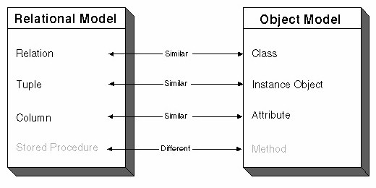
Object-Relational Data Models
Relational model: flat, “atomic” values
Object Relational Data Models
  Extend the relational data model by including object orientation and constructs to deal with added data types.
  Allow attributes of tuples to have complex types, including non-atomic values such as nested relations.
  Preserve relational foundations, in particular the declarative access to data, while extending modeling power.
  Provide upward compatibility with existing relational languages.

Slide 18
Database Architecture
The architecture of a database systems is greatly influenced by
the underlying computer system on which the database is running:
Centralized
Client-server
Parallel (multi-processor)
Distributed

Slide 19
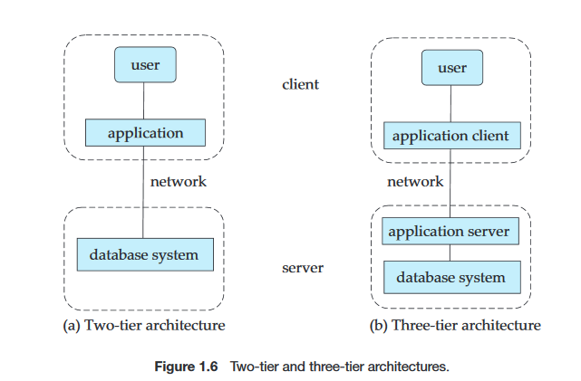
In a two-tier architecture, the application resides at the client machine, where it invokes database system functionality at the server machine through query language statements.
In contrast, in a three-tier architecture, the client machine acts as merely a front end and does not contain any direct database calls. Instead, the client end communicates with an application server, usually through a forms interface.

Slide 20
Database Engine
Storage manager
Query processing
Transaction manager

Slide 21
Storage Management
Storage manager is a program module that provides the interface between the low-level data stored in the database and the application programs and queries submitted to the system.
The storage manager is responsible to the following tasks:
  Interaction with the OS file manager
  Efficient storing, retrieving and updating of data
Components:
  Authorization and Integrity manager
  Transaction manager
  File manager
  Buffer manager
Data structures:
  Data files
  Data dictionary
  Indices

Slide 22

Query Processing
Tasks:
1. Parsing and translation
2. Optimization
3. Evaluation
Components:
DDL Interpreter
DML compiler
Query optimizer
Query evaluation Engine

Slide 23
Transaction Management
What if the system fails?
What if more than one user is concurrently updating the same data?
A transaction is a collection of operations that performs a single logical function in a database application
Transaction-management component ensures that the database remains in a consistent (correct) state despite system failures (e.g., power failures and operating system crashes) and transaction failures.
Concurrency-control manager controls the interaction among the concurrent transactions, to ensure the consistency of the database.

Slide 24

Database Users and Administrators
Database

Slide 25

Database System Internals

Slide 26
Database Administrator (DBA)
A person having central control of both data and programs that access those data is called database administrator.
The functions of a DBA:
  Schema definition
  Storage structure and access method definition.
  Schema and physical organization modification.
  Granting authorization for data access.
  Routine maintenance.
    Periodically baking up the database
    Disk space management
    Monitoring jobs running on database

Slide 27
End of Chapter 1

